Slide 1


COVER SLIDE
WELCOME MESSAGE HERE!

Slide 2

BASIC CONTENT: TITLE GOES HERE
168th COMMENCEMENT CEREMONY

Slide 4
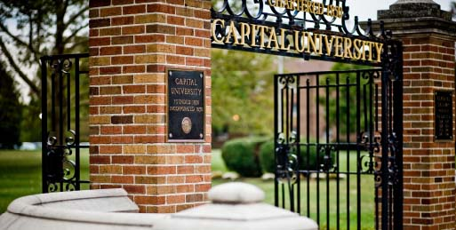
PROLOGUE CONCERT
Symphonic Winds, Jeffrey D. Gershman, D.M.A., Conductor
END OF PRESENTATION
THANK YOU!

